Slide 1
Fusor: 符号执行安全的代码混淆工具
赵子瑞、徐辉、周扬帆、谢涛、吕荣聪

Slide 2



Fusor简介
基于源代码的混淆工具，以LLVM Pass的方式运行
主要用户群体是程序员，在编译代码的时候调用
混淆的作用是抵御逆向工程，目的是保护软件知识产权
LLVM编译器
输入
中间代码
输出
前端
后端
源代码
Fusor
可执行代码

Slide 3
现有混淆工具面临的一个主要挑战：符号执行
论文 | 标题 | SE工具
Guillot’2010 | Automatic binary deobfuscation | N/A
Ming’2015 | LOOP: Logic-oriented opaque predicate detection in obfuscated binary code | BAP
Yadegari’2015a | A generic approach to automatic deobfuscation of executable code | N/A
Yadegari’2015b | Symbolic execution of obfuscated code | N/A
Banescu’2015 | A framework for measuring software obfuscation resilience against automated attacks | KLEE
Xu’2017 | Cryptographic function detection in obfuscated binaries via bit-precise symbolic loop mapping | BAP
Bardin’2017 | Backward-bounded dse: Targeting infeasibility questions on obfuscated codes | BINSEC/SE
David’2017 | Formal approaches for automatic deobfuscation and reverse-engineering of protected codes | BINSEC/SE
Xu’2018 | Vmhunt: A verifiable approach to partially-virtualized binary code simplification | BAP

Slide 4
安全问题举例：Crackme
CTF 题目: https://github.com/angr/angr-doc/tree/master/examples/fauxware
angr破解用了1.669 秒
使用Obfuscator-LLVM 混淆后，angr仍然在1.737秒破解正确
char *sneaky = "SOSNEAKY";
int authenticate(char *username, char *password)
{
char stored_pw[9];
stored_pw[8] = 0;
int pwfile;
if (strcmp(password, sneaky) == 0) return 1;
pwfile = open(username, O_RDONLY);
read(pwfile, stored_pw, 8);
if (strcmp(password, stored_pw) == 0) return 1;
return 0;
}
* Intel(R) Core(TM) i7-8086K CPU @ 4.00GHz, 16GB DDR4 RAM, Debian Stretch; angr version: 8.18.10.25
* OLLVM version: 3.6.1

Slide 5
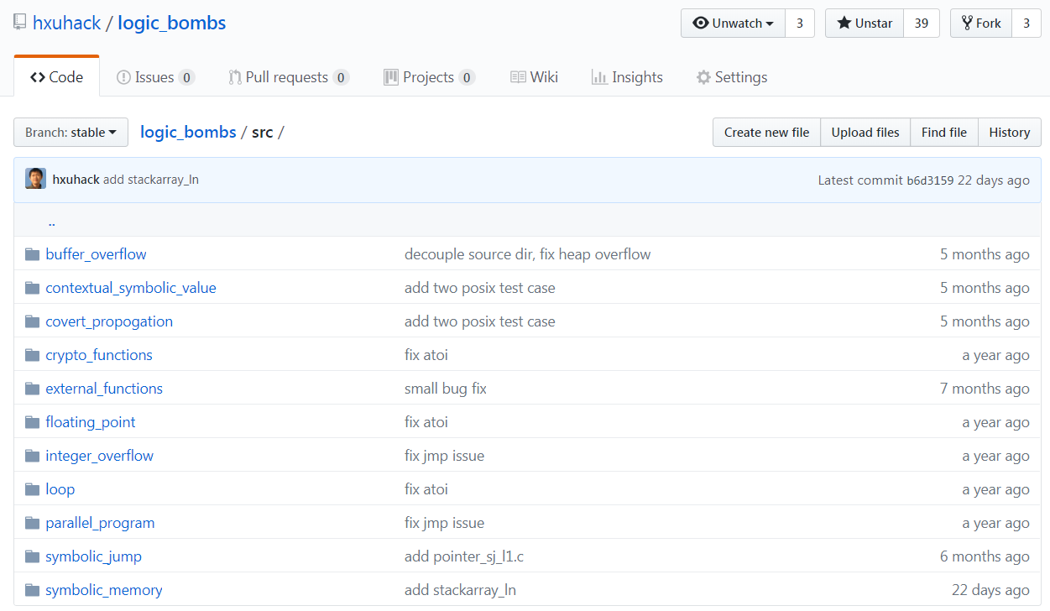


思路：利用符号执行的弱点进行代码混淆
Developed at Stanford (2008)
https://klee.github.io/
angr
Developed at UCSB (2016)
http://angr.io/
Developed at Quarkslab (2015)
https:// triton.quarkslab.com

Slide 6
测试结果
问题 |  | 结果 (通过 #/ 总数 #)
 |  | KLEE | Triton | Angr
Symbolic-Reasoning Challenges | Symbolic Variable Declaration | 0/7 | 0/7 | 0/7
 | Covert Propagations | 1/5 | 1/9 | 4/9
 | Buffer Overflows | 0/4 | 0/4 | 2/4
 | Parallel Executions | 0/5 | 0/5 | 0/5
 | Symbolic Memories | 5/6 | 0/8 | 7/8
 | Contextual Symbolic Values | 0/7 | 0/7 | 0/7
 | Symbolic Jumps | 1/1 | 0/4 | 2/4
 | Floating-Point Numbers | 0/5 | 0/5 | 2/5
 | Arithmetic Overflows | 2/2 | 1/2 | 2/2
Path-Explosion Challenges | Loops | 0/5 | 0/5 | 0/5
 | Crypto Functions | 0/2 | 0/2 | 0/2
 | External Function Calls | 0/8 | 1/8 | 3/8
Total |  | 9/54 | 3/63 | 22/63

Slide 7
核心原理：构造安全的Opaque Predicate
int func(int i){
int l1_ary[]={1,2,3,4,5};
int l2_ary[]={i,1,2,3,4,5};
int j = l2_ary[l1_ary[i%5]];
if(i == j)
foo()
else
bogus();
}
1
2
3
int func(int i){
foo();
}
1
2
3
4
5
6
7
8
9
1
2
3
4
5
6
7
8
int func(char i){
float f = i/1000000.0;
if(1024+f==1024 && f>0)
foo();
else
bogus();
}
原始代码
利用Symbolic Memory问题
利用浮点数问题

Slide 8
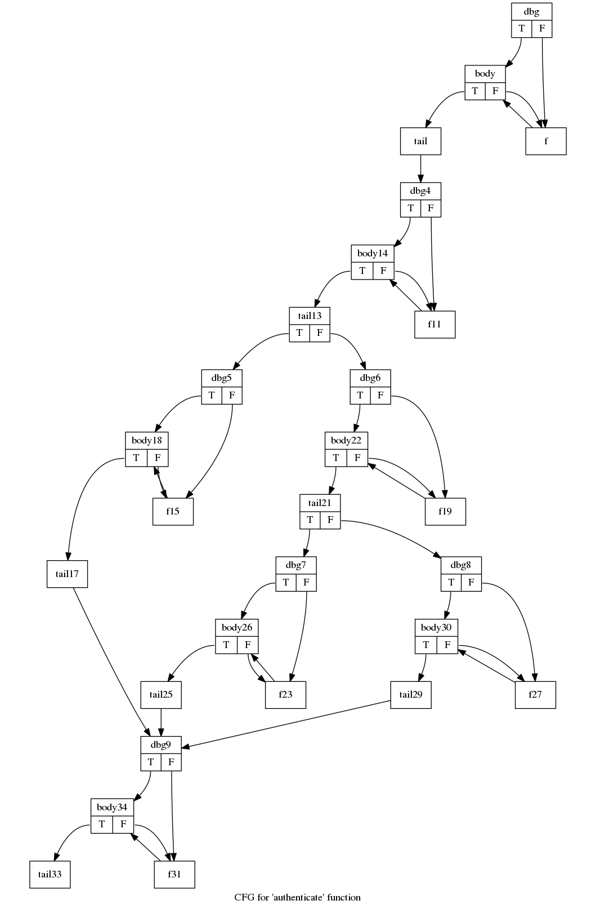
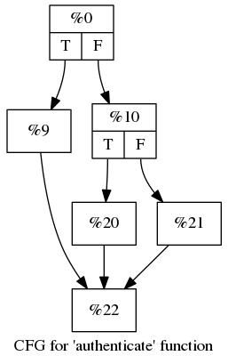
安全效果
前面的CFT问题angr在4.3秒后给出了错误答案
angr的错误输出: >SK
正确结果: SOSNEAKY
Fusor混淆

Slide 9

Fusor简便易用

Slide 10
性能优势：空间效率
**
* OpenSSL version: 1.1.1; All obfuscations were run once.
** Coreutils version: 8.30; All obfuscations were run once.
*** Fusor-128A-100%: Used array-based opaque predicate with 100% obfuscation rate. 1st depth=3, 2nd depth=5

Slide 11
性能优势：运行效率
**
* OpenSSL version: 1.1.1; All obfuscations were run once.
** Coreutils version: 8.30; All obfuscations were run once.
*** Fusor-128A-100%: Used array-based opaque predicate with 100% obfuscation rate. 1st depth=3, 2nd depth=5

Slide 12
工具理论基础
“Benchmarking the Capability of Symbolic Execution Tools with Logic Bombs,” Hui Xu, Zirui Zhao, Yangfan Zhou, and Michael R. Lyu, in Transactions on Dependable and Secure Computing (TDSC), 2018.
“Manufacturing Resilient Bi-Opaque Predicates against Symbolic Execution,” Hui Xu, Yangfan Zhou, Yu Kang, Fengzhi Tu and Michael R. Lyu, in Proceedings of the 48th IEEE/IFIP International Conference on Dependable Systems and Networks (DSN), Luxembourg, 2018.
“Concolic Execution on Small-Size Binary Codes: Challenges and Empirical Study,” Hui Xu, Yangfan Zhou, Yu Kang, and Michael R. Lyu, in Proceedings of the 47th IEEE/IFIP International Conference on Dependable Systems and Networks (DSN), Denver, USA, 2017.

Slide 13
谢谢，恳请专家指正!

